Slide 1

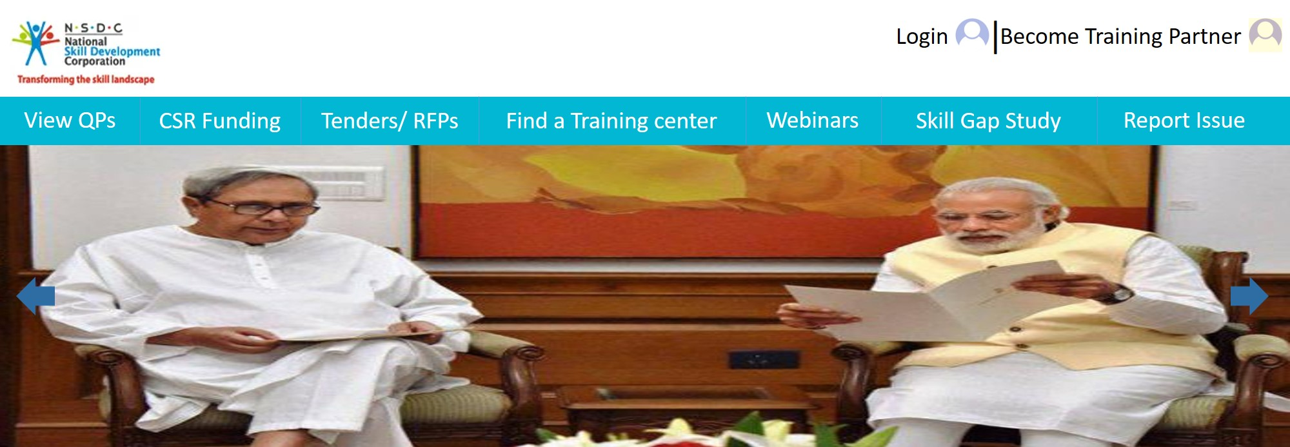
Existing training partner can REGISTER ONLINE FOR NEW QUALIFICATION PACKS by existing training partner
ONLINE TRAINING SESSIONS can be integrated with National Informatics Center(NIC)
Local user can have better readability by
MULTILINGUAL Feature
Training Partner can have PERSONALIZED HOMEPAGE for Monitoring their application status
CSR Funds can be closely monitored.
Source
Amount
Used at
INTEGRATING THE DESKTOP ASSESSMENT OF TP in the application.
SEGREGATION of students FOR WORLD’s COMPETITION
on different levels
ONLINE ACCREDIATION & RENEWAL
PROCESS
of training centers
MONITORING Sector Skill Councils
MOBILE APPLICATION
For notifying users for latest news and events update
SKILL INDIA APP | FUTURE SCOPE

